Slide 1



Premier University
Robotics Club
Presentation On
Lead Screw Stepper Based Automated Multilevel Parking
Supervised by
Mohammed Saifuddin Munna
Lecturer
Department of EEE
Premier University
Presented by
Name: MD Shahnewaz Ahsan
ID: 1401611200728
Ehsan.puc16@gmail.com
Dept. of EEE Premier University

Slide 2
Contents
Introduction.
Objective.
Block Diagram.
Mechanical Design.
Drawing Overview.
Algorithm.
Final Prototype.
Practical Implementation Analysis.
Conclusion.
Dept. of EEE Premier University

Slide 3
Introduction
This project aims to develop an automated
multilevel parking system prototype which
will be efficient with minimum cost for
densely populated cities in Bangladesh.
Dept. of EEE Premier University

Slide 4
Objective
To study the parking system in some vital areas of Chittagong.
To automate the parking system process.
To design and implement a prototype for various Market and residential areas.
Dept. of EEE Premier University

Slide 5
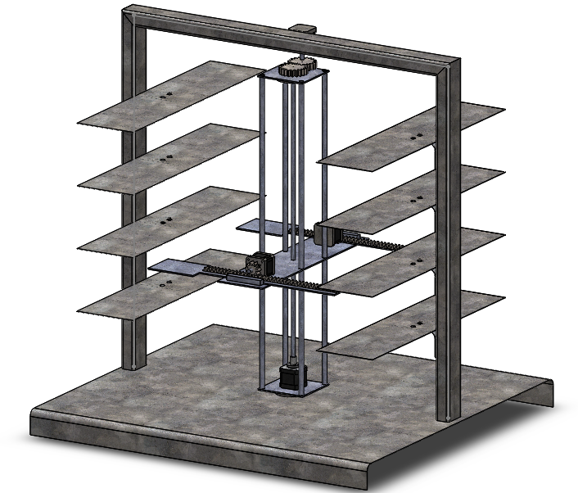
Mechanical Design
Software : Solidworks 2016
Designed by : Ehsan Suny
Dept. of EEE Premier University

Slide 6
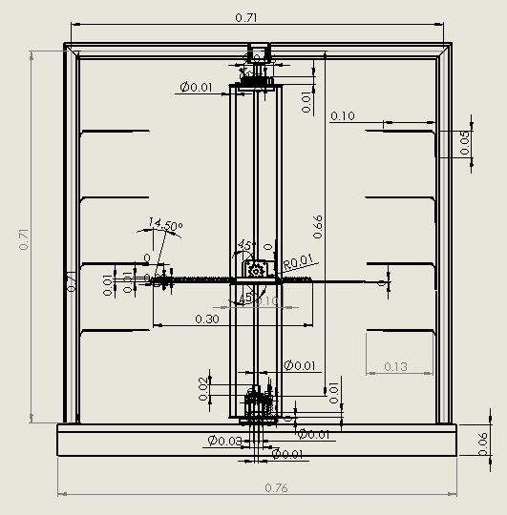
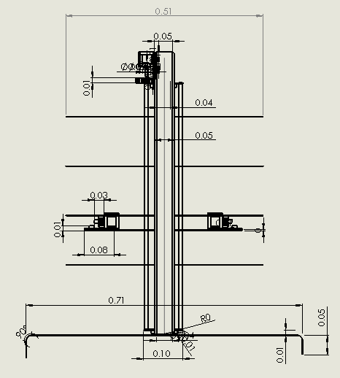
Drawing Overview
Software : Solidworks 2016
Designed by : Ehsan Suny
Dept. of EEE Premier University

Slide 7
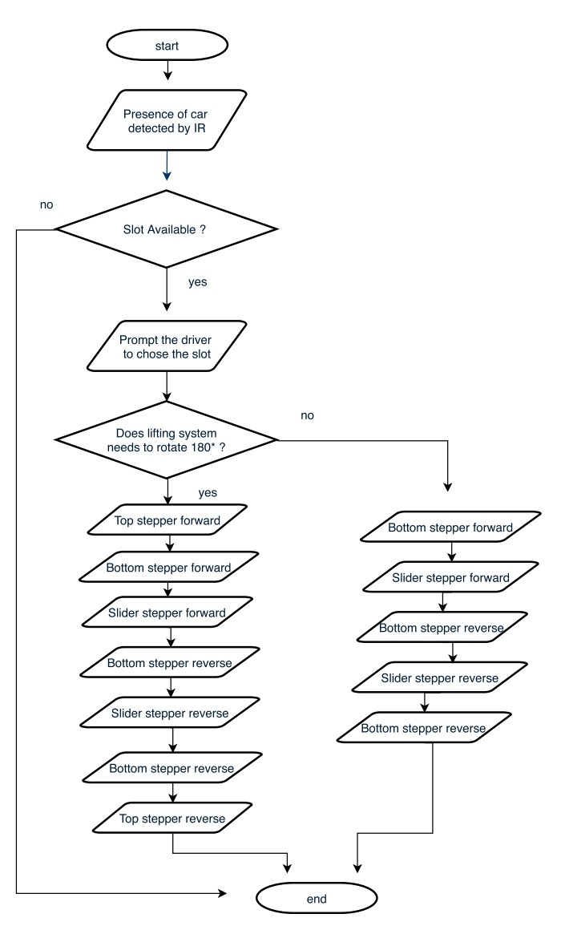
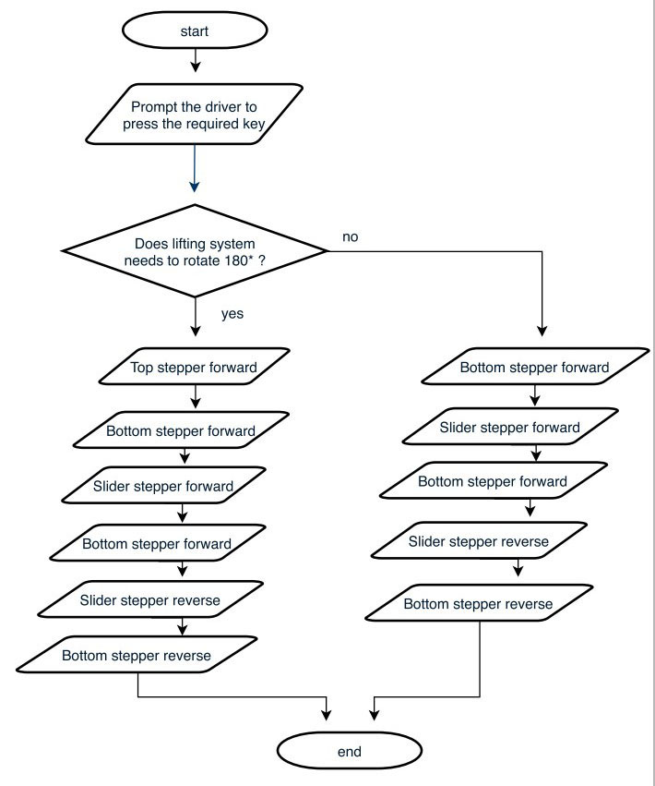
Algorithm
Dept. of EEE Premier University

Slide 8
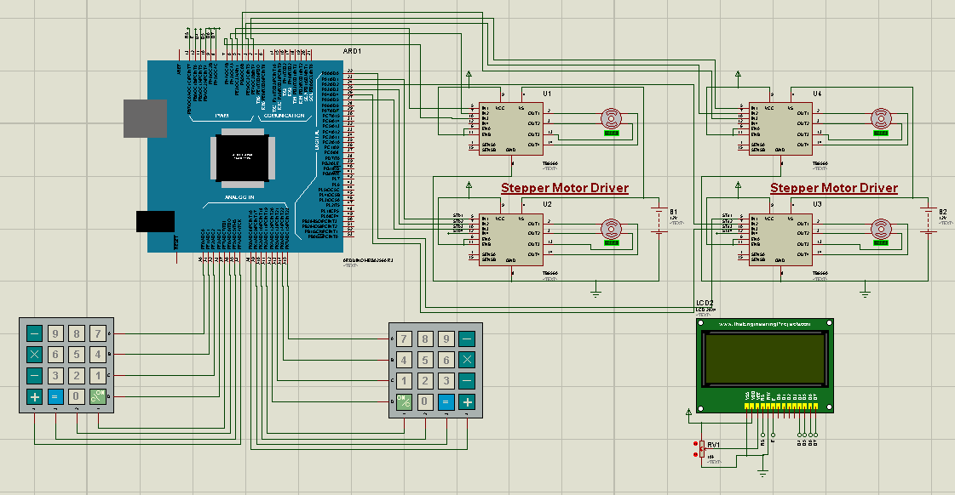
Circuit Diagram
Dept. of EEE Premier University

Slide 9
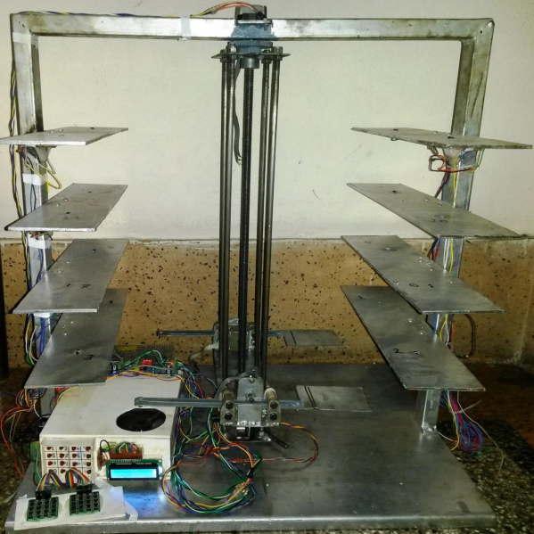
Final Prototype
Dept. of EEE Premier University

Slide 10
Practical Implementation
Table iii: Capacity and size of different multilevel parking
Car Parking Configuration | Capacity | Dimension | Number of lifts
Semi Autonomous Elevator type | 10-50 cars 5 cars in 45m2 per unit or floor | Length: 5.2 m Width: 2.25m Height: 2 m | Rail or Elevator
Autonomous lead screw stepper type | 16-32 cars 4 cars in 25 m2 per floor | Length: 5.05 m Width: 2.04 m Height: 1.55 m | Central Screw lift
Table iv: Retrieval time for different multilevel parking
Car Parking Configuration | Capacity | Retrieval time | Number of Entry/Exit bays
Semi Autonomous Elevator type | 10-50 cars 5 cars in 45m2 per unit or floor | 30-60 sec | 2 entry and 2 exit bay
Autonomous lead screw stepper type | 16-32 cars 4 cars in 25 m2 per floor | 25-30 sec | Only 2 entry and exit bay.
Dept. of EEE Premier University

Slide 11
Practical Implementation
Table i: Requirements of different types of parking
Car parking type | Continuous Power supply | Protection for externals | Entry & Exit point | Collection System
Semi- Autonomous | Medium | High | Single | Manual
Semi-Autonomous | High | High | Double | Unmanned
Table ii: Costs of multilevel parking types
Car parking type | Costs 40-50 million BDT (Approx ) |  |  |  | Cost /space
 | land | Cons. | Soft. | Develop. | Const. | operation
Semi- Autonomous | 12 | 7.5 | 0.4 | 20 | 32,000 | 395/month
Semi-Autonomous | 12 | 15 | 0.7 | 28 | 20,000 | 265/month
Dept. of EEE Premier University

Slide 12
Conclusion
Advantage : Unmanned and Frictionless lifting system.
Accuracy : High torque Stepper motor gives more stepping accuracy than DC motor.
Limitation : Applicable for Market and residential area.
Dept. of EEE Premier University

Slide 13
Reference
www.scientific.net
www.ijettjournal.org
www.ijfcc.org
http://nevonProjects.com
http://dspace.bracu.ac.bd
http://ijesc.org
www.internationaljournalssrg.org
Dept. of EEE Premier University

Slide 14
Thank You all
Dept. of EEE Premier University

